Slide 2
2th International Congress Disease Registry and Patient outcome
Report

Slide 3
Congress Organizations
Deputy of Research, MOHME
Deputy of Research, TUMS
Cancer Research Center of Cancer Institute
Sharif Management & Health Development institute

Slide 4
Scientific committee

Slide 5
Special Thanks To
Dr Gholamreza Hassanpour
Dr Gholamreza Roshandel
Dr Khalil Kimiafar
Dr Marjan Ghazi Saeedi
Dr Abbas Sheikhtaheri
Miss Monireh Sadat Sayyed Salehi

Slide 6
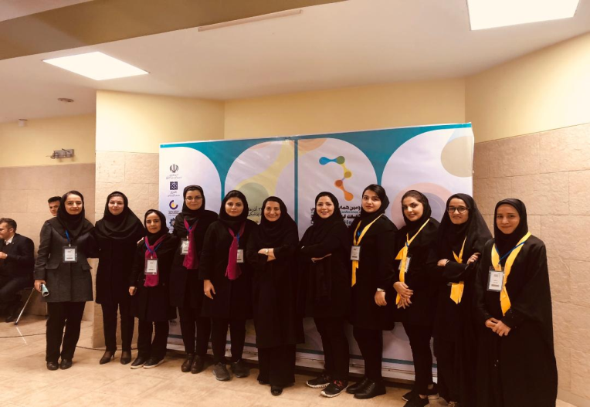
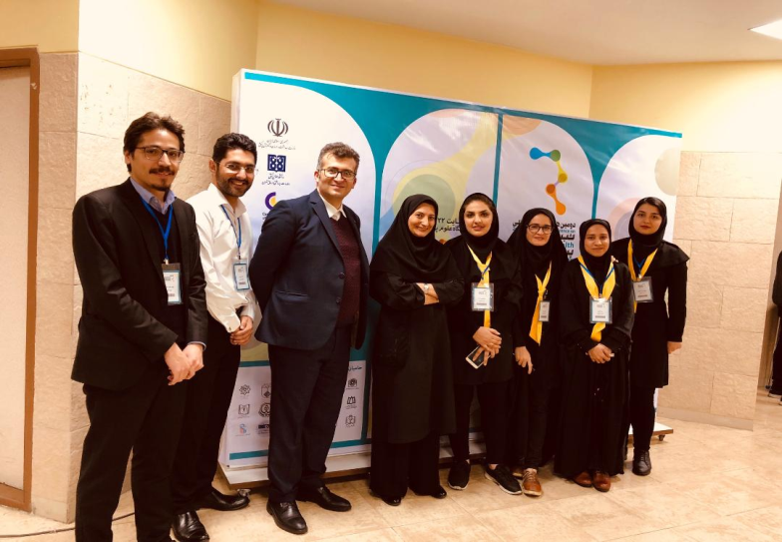
Executive Committee
Sharif Management & Health Development institute
Cancer Research Center of Cancer Institute
School of Allied Medical Sciences
Secretariat of Disease Registry in TUMS
Secretariat of Disease Registry in MOHME

Slide 7
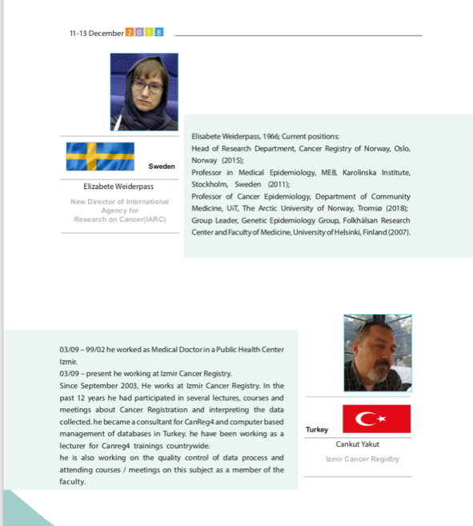
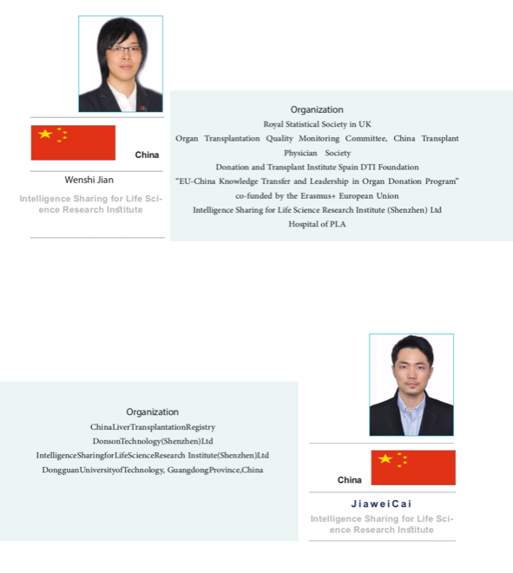
International Speakers

Slide 8
Target Groups and Audiences of the Conference
Universities
Researchers
Research centers
Clinical doctors working in the field of registry
Health Professionals
Software Information Technology Professionals
Medical records specialists

Slide 9
Topics
Protocols and management of registry systems
Classification & coding
Role of health information technology in disease registries
The role of disease registries to promote health care system quality
Quality control methods in registry programs
Analytical methods in disease registries
Ethics ,data ownership & data exchange in registries
Bio banks and registry programs
The role of registries in health care system and control of non-communicable diseases

Slide 10
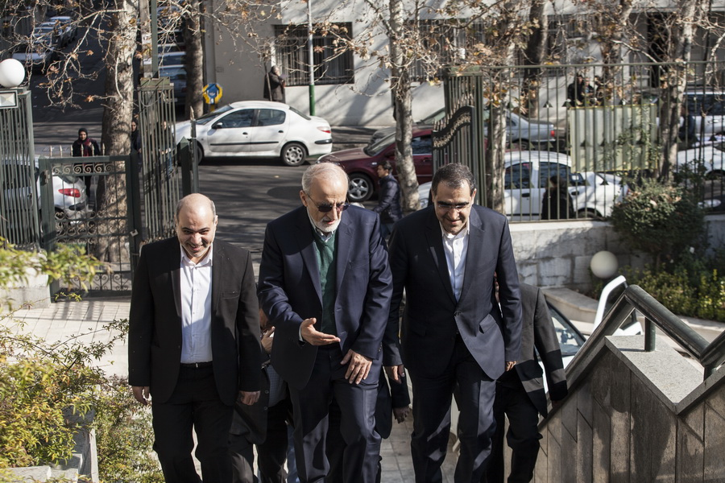
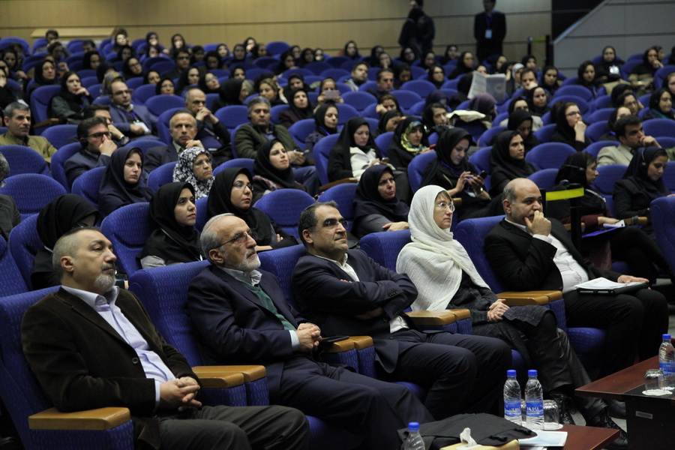
Opening Ceremony
Health Minister promise:
-Supporting Patients registries
-Supporting to promote Quality of registries

Slide 11
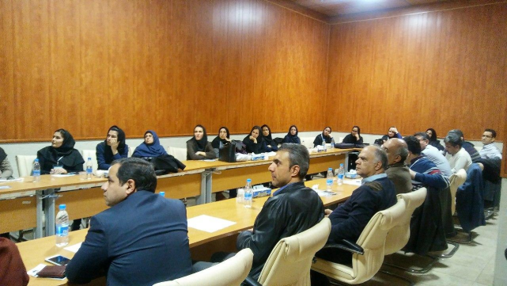
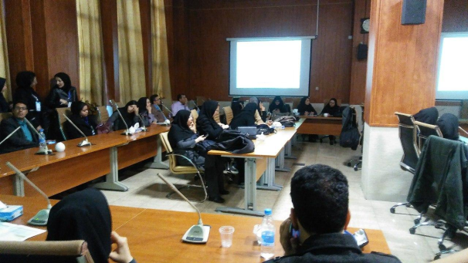
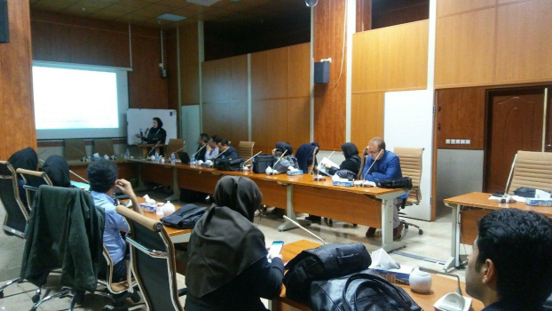
Workshops
Data Mining
Quality control of population based cancer registry
Steps to implement patient registry
DHIS2

Slide 12
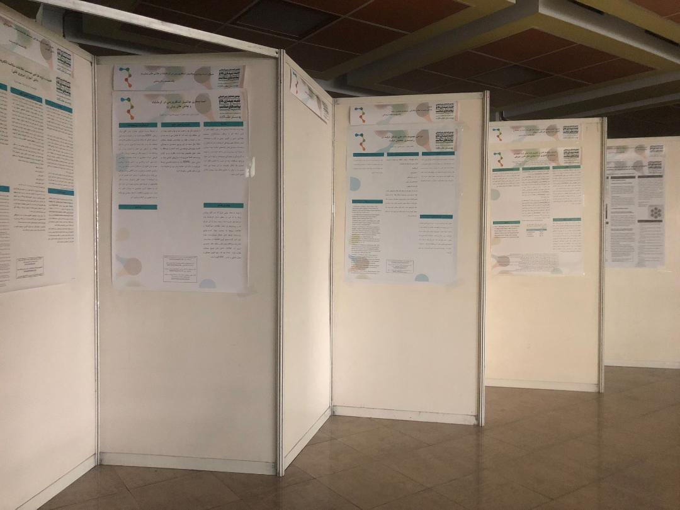
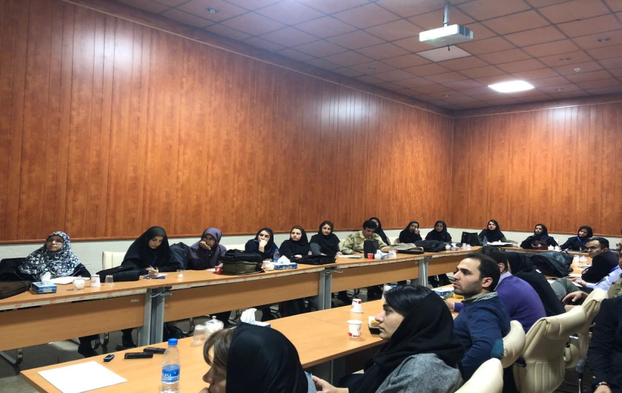
Report of Participants
447 participants
156 Articles
71 Posters
46 lectures

Slide 13
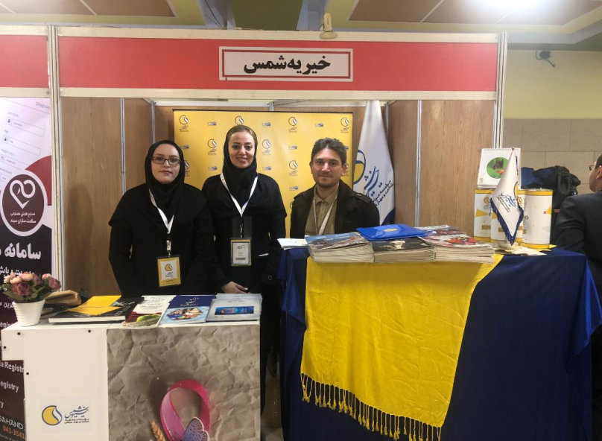
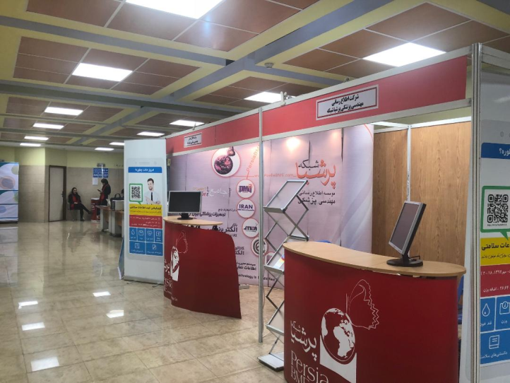
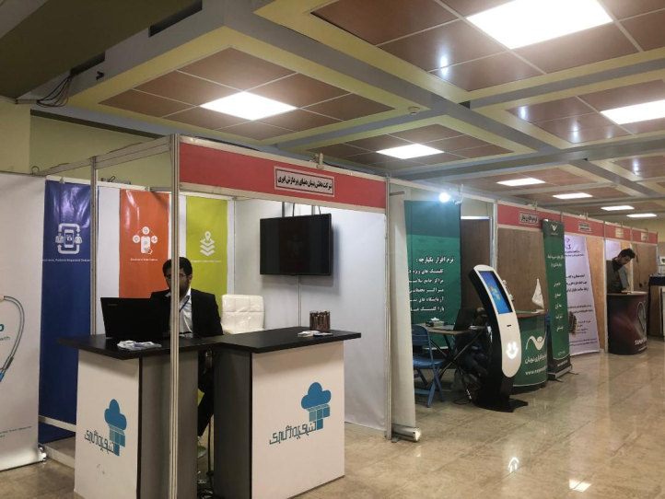
Exhibitions
6 ICT Companies
1 research Centers
1 Cancer NGOs(Shams)

Slide 14
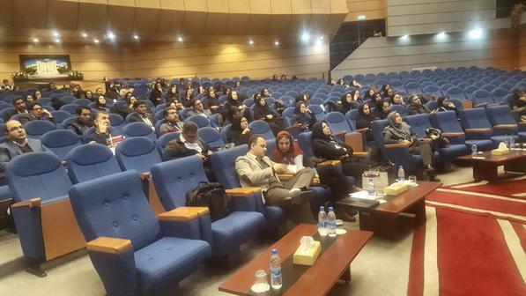
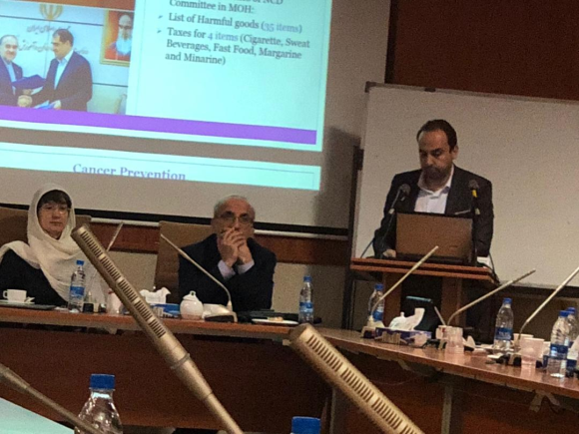
On the sideline of Congress
Workshop on reporting and publication of cancer registry data(deputy of health MOHME)
Visiting Shiraz for Cancer registry Infrastructure and research
Meet the professor: Elizabete weiderpass and cancer specialists meeting.
Expert panel: designing protocol for publishing data registry
Meeting in International affairs MOHME with International guests
Meeting in Deputy of Treatment MOHME with International guests
Meeting in transplantation Association with International guests

Slide 15
به پایان آمــد این دفتــر حکایت همچنان باقی‌ست...

